Slide 1

Fund portfolio management system based on SpringBoot+VUE+SQL
Team Twenty

Slide 2

Content
Our Team
Database
Back-End
Front-End
Conclusion
Diagram
Project Overview
Demo

Slide 3



OUR Team
Li , Chunyu
Back-End( SpringBoot，Microservice Construction , Environment Debugging , Interface Data Connection, Computational Logic Design)
Chen , Jie
Front-End( Vue Framework, Front-end framework design , UI , interface data connection , Computational Logic Design )
Cui , Yilun
Database( Database Construction , Data Loader , Module Design , Framework Design , Computational Logic Design Document Writing)

Slide 4

Team schedule
STEP 5
STEP 3
Tests and Documentation
Back-End Coding
8.21-8.23
Module Test
Document Writing
STEP 1
8.14-8.17
Module Coding
Front-end static page
Database Construction
8.8 – 8.10
Database Construction
Data Cleaning
Data Loader
STEP 2
STEP 4
Business Analysis
Front-End Coding and API Connection
8.18-8.20
Front-end and back-end data connection
Module Function Optimization
8.11-8.13
Page Design
Modules Design
Technical Research

Slide 5
Content
Our Team
Project Overview
Diagram
Database
Back-End
Front-End
Demo
Conclusion

Slide 6
Project overview
A management system should have effective functions such as fund management, product management, value analysis, and market browsing. To sum up, our team built a visual fund management tool based on Springboot+vue+sql, on which users can freely buy and sell funds and manage their own funds.

Slide 7
Content
Our Team
Project Overview
Diagram
Database
Back-End
Front-End
Demo
Conclusion

Slide 8
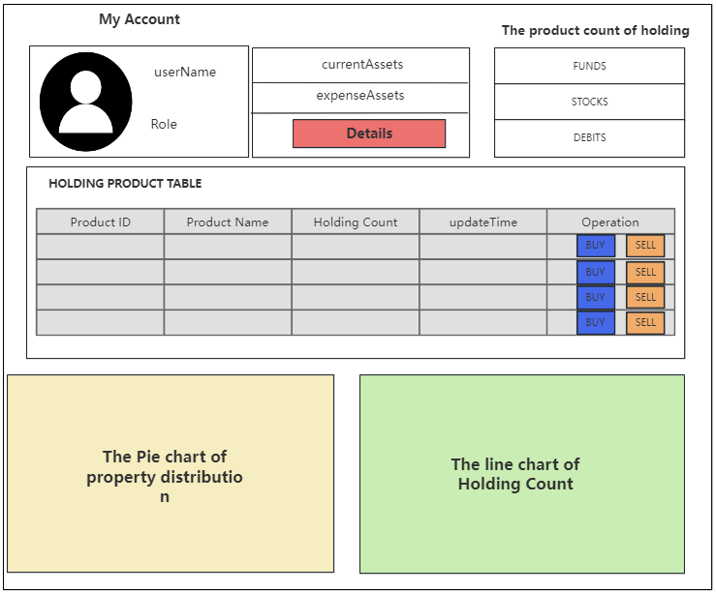
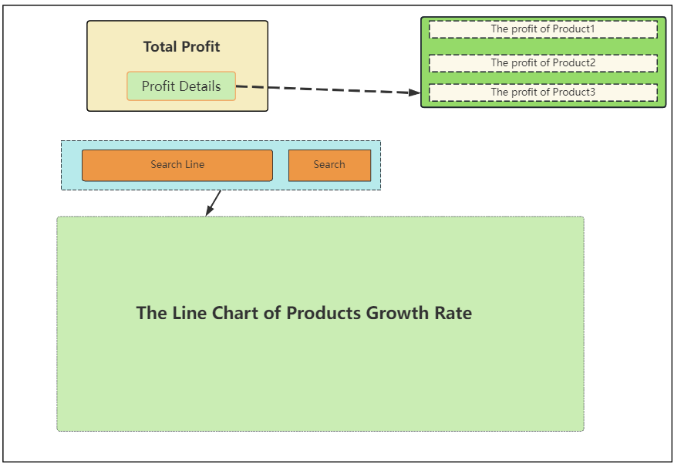
Diagram
Page-1 Information about Assets and Assets Distribution
Page-2 The Profit of Assets Page

Slide 9
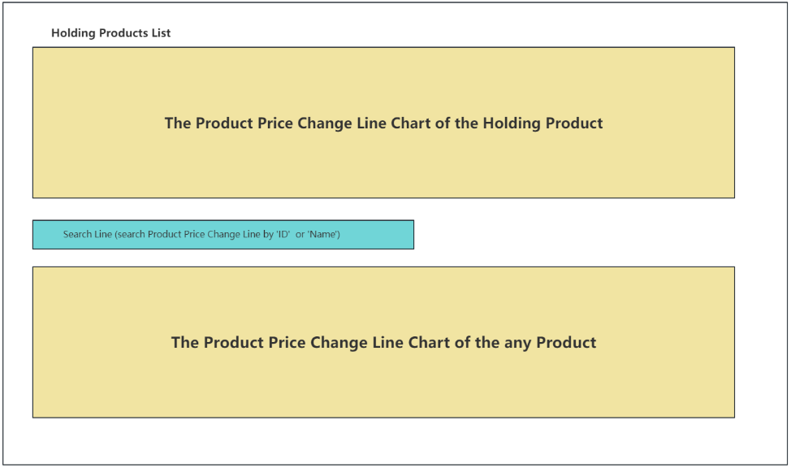
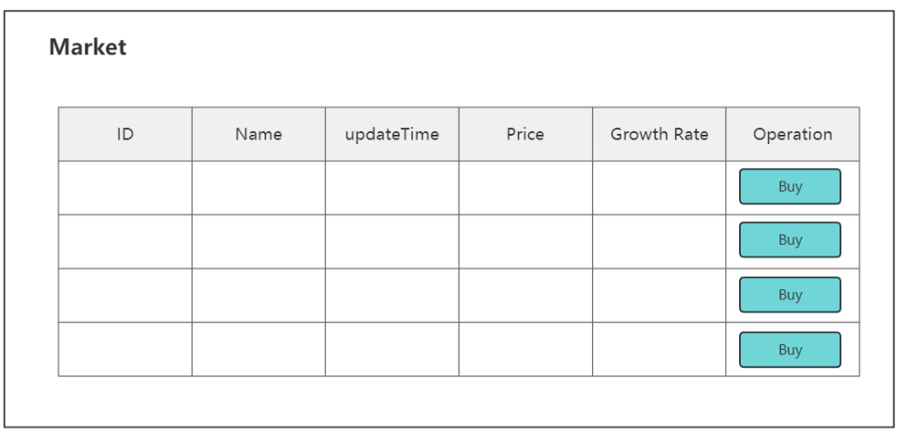
Diagram
Page-3 Product Price Change Monitoring Module
Page-4 Market

Slide 10
Diagram
Page-3 Product Price Change Monitoring Module
Page-4 Market

Slide 11
Content
Content
Our Team
Project Overview
Diagram
Database
Back-End
Front-End
Demo
Conclusion

Slide 12
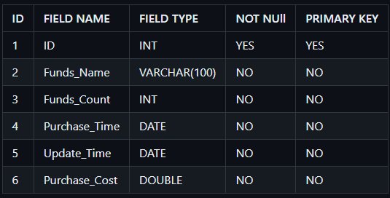
Database
TABLE 1: RECORD
Funds_Name : Identifier in the table.
Funds_Count : Used to show the count of holding fund.It will change after operation 'BUY' or 'SELL’.
Purchase_Time : When the fund was purchased for the first time.
Update_Time : When the fund was operated for the last time..
Purchase_Cost : The current cost price of buying the fund.

Slide 13
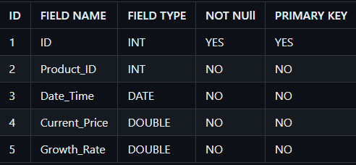
Database
TABLE 2: PRODUCT
ID : Identifier in the table.
Product_ID :This field corresponds to the id in the record table. It is used to associate the relationship between the two tables.
Date_Time : The current date of the fund.
Current_Price : The price of the fund on date 'Date_Time’.
Growth_Rate :The growth rate of the fund on date 'Date_Time'.

Slide 14
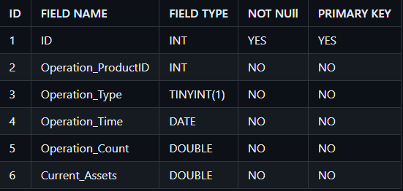
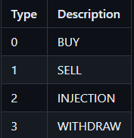
Database
TABLE 3 : OPERATION
ID : Identifier in the table.
Operation_ProductID :This field corresponds to the id in the record table. It is used to associate the relationship between the two tables.
Operation_Type : We use different values 0,1,2,3 to represent different operation types .
‘Operation_Type’ include four kinds of operations.

Slide 15
Content
Our Team
Project Overview
Diagram
Database
Back-End
Front-End
Demo
Conclusion

Slide 16
Spring boot
Spring Boot makes it easy to create stand-alone, production-grade Spring based Applications that you can “just run”.
Simplified Configuration
Embedded Web Server
Auto-Configuration
Microservices Support
Developer-Friendly
High Customizability
……

Slide 17
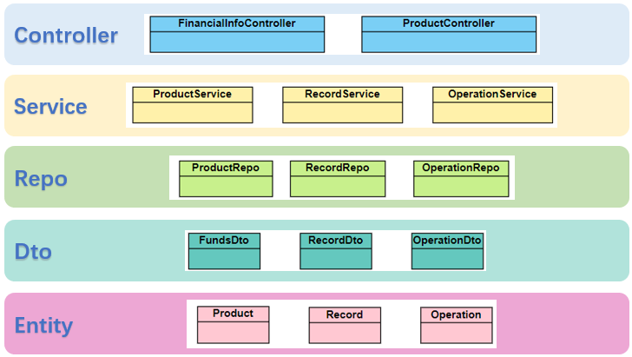
Back-end
We adopted the classic SpringBoot architecture.

Slide 18
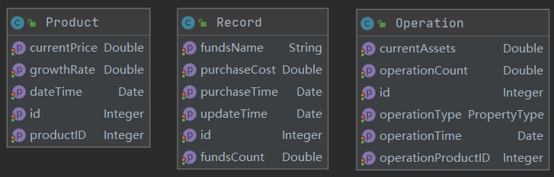
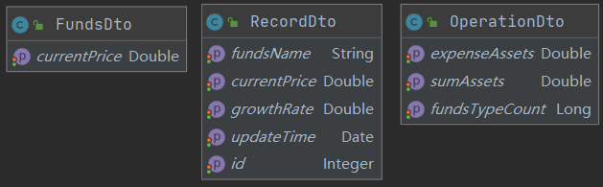
Back-end
@Entity @Table(name = "record")
@Entity @Table(name = "product")
@Entity @Table(name = "operation")
@Data

Slide 19
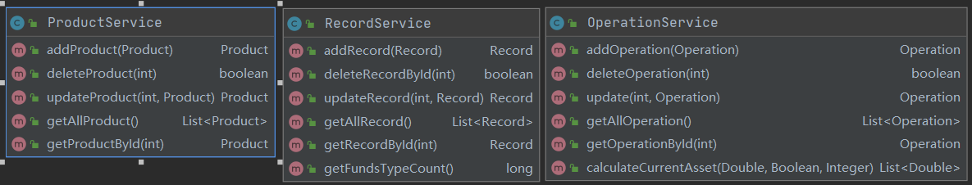
Back-end
public interface OperationRepo extends JpaRepository<T,ID>
public interface ProductRepo extends JpaRepository<T,ID>
public interface RecordRepo extends JpaRepository<T,ID>
@Repository
@Service

Slide 20
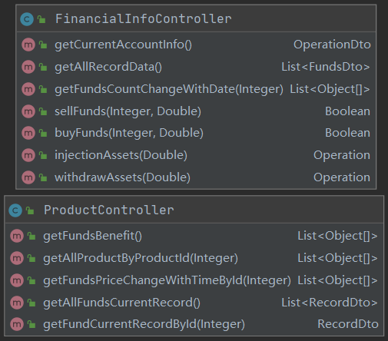
Back-end
@RestController @RequestMapping("/api/financialinfo")
http://localhost:8080/api/financialinfo/account
http://localhost:8080/api/financialinfo/funds
http://localhost:8080/api/financialinfo/count?operationProductID=1
http://localhost:8080/api/financialinfo/sell?id=20&fundsCount=10000
http://localhost:8080/api/financialinfo/buy?id=20&fundsCount=10000
http://localhost:8080/api/financialinfo/injection?injectionAmount=100000000
http://localhost:8080/api/financialinfo/withdraw?withdrawAmount=100000000
http://localhost:8080/api/product/profitrate?productId=20
http://localhost:8080/api/product/fundsprice
http://localhost:8080/api/product/allproducts
http://localhost:8080/api/product/allproducts/20
http://localhost:8080/api/financialinfo/buy?id=20&fundsCount=10000

Slide 21
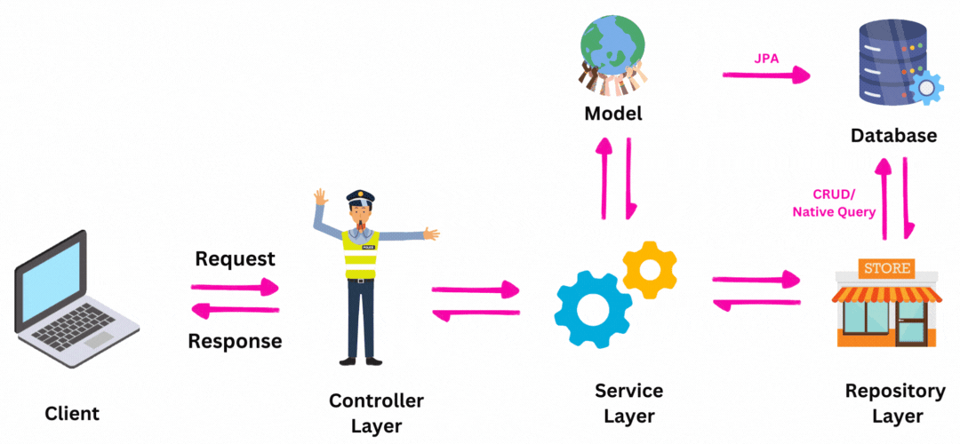
Back-end
Data streaming is shown in the figure:
spring.datasource.username = testuser spring.datasource.password = X26nmra1996 spring.datasource.url = jdbc:mysql://rm-cn-zsk3ccekg000jbo.rwlb.rds.aliyuncs.com:3306/javapreroom20

Slide 22
BACK-end
For the detailed description of the interface part, we have written in the following documents：
https://github.com/Raincatshine/groupTwentyFinancialPortfolio/blob/main/README.md

Slide 23
Content
Our Team
Project Overview
Diagram
Database
Back-End
Front-End
Demo
Conclusion

Slide 24

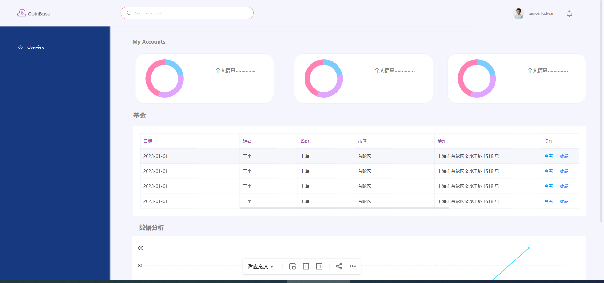
Front-end
prototype design
UI design

Slide 25
Front-end
Router
Basic Framework：Vue
-
Network：Axios
Stage Management：Vuex
Route Management ：Router
Visualization：Echarts
UI extension：Element-UI
Echarts
Vuex
VUE
ElementUI
Axios

Slide 26
Front-end
|-- src
|-- components
| |-- Index.vue
| |-- accountInfo
| | |-- accountInfo.vue
| |-- dataCharts
| | |-- chartExample.vue
| |-- fundsList
| | |-- fundsList.vue
| |-- headerBar
| |-- headerBar.vue
|-- view
|-- financialInfo
| |-- financialInfo.vue
|-- fundsDetail
| |-- fundsDetail.vue
|-- fundsMarket
| |-- fundsMarket.vue
|-- Profit
|-- Profit.vue
components

Slide 27
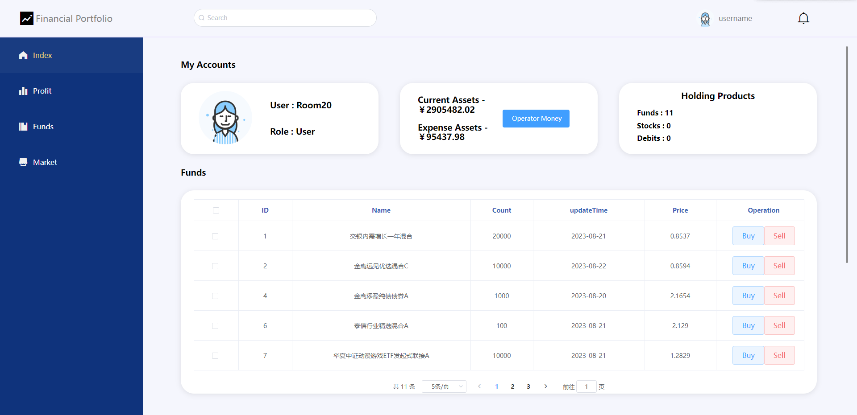
Front-end
Components for Page
Components for view

Slide 28
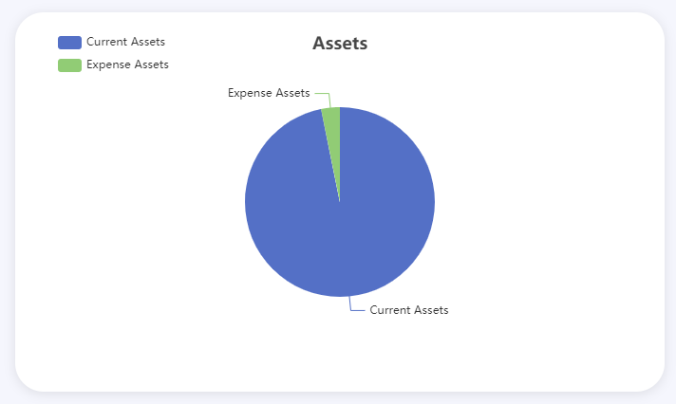
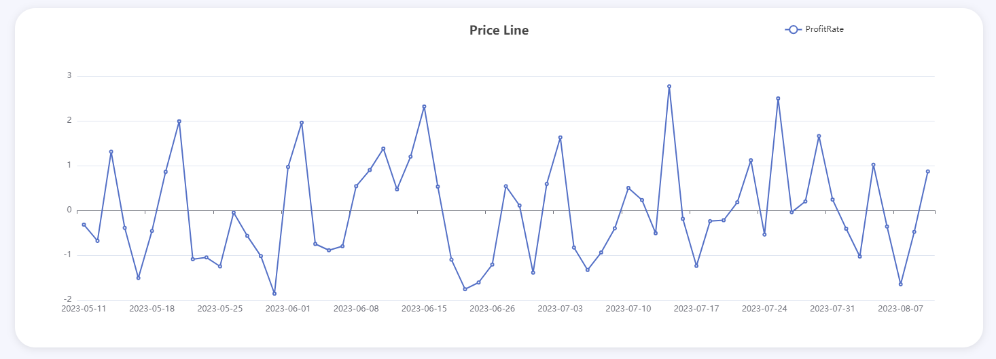
Front-end
chartExample.vue
encapsulation
Options
Pie Chart
Line Chart

Slide 29
Content
Our Team
Project Overview
Diagram
Database
Back-End
Front-End
Demo
Conclusion

Slide 30
Demo

Slide 31
Content
Our Team
Project Overview
Diagram
Database
Back-End
Front-End
Demo
Conclusion

Slide 32
Conclusion
We implemented the basic functionality of our design system. Include CRUD and interface debugging.
A reasonable and feasible fund system is designed to manage users' assets.
In the actual work, we found many problems and difficulties.
Communication problem.
There are still some not standard code.
Some of the logic set by the system is not realistic enough.

Slide 33

THANKS

